Slide 1
Network : Transport Protocols (1)
Jae Hyeon Kim

Slide 2
Reference
William Stalling, Data and Computer Communications 10/E, Prentice Hall

Slide 3
Transport Protocols
End-to-end transport of data that shields the user from the details of the underlying communication systems
Reliable, connection oriented : has greater complexity, e.g. TCP
Best effort, connectionless : datagram, e.g. UDP
Connection-oriented transport protocol mechanisms
Provides establishment, maintenance and termination of a logical connection between TS(Transport Service) users
Most common service for a wide variety of applications
Is reliable, but complex

Slide 4
Reliable Sequencing Network Service
Transport service is a simple end to end protocol between two systems on the same network
However, its situation on internet would be so complex
Because the below layer, so IP, provide a best-effort delivery
Issues are :
Addressing
Multiplexing
Flow control
Connection establishment and termination

Slide 5
Addressing
Transport protocol must be able to derive the following information from the TS user address
User identification
A socket in TCP
Port represents a particular transport service user
Multiple users employ the same transport protocol and are distinguished by port numbers
Transport entity identification (on host)
Specify transport protocol (TCP, UDP)
Host address of attached network device
In the internet, a global internet address

Slide 6
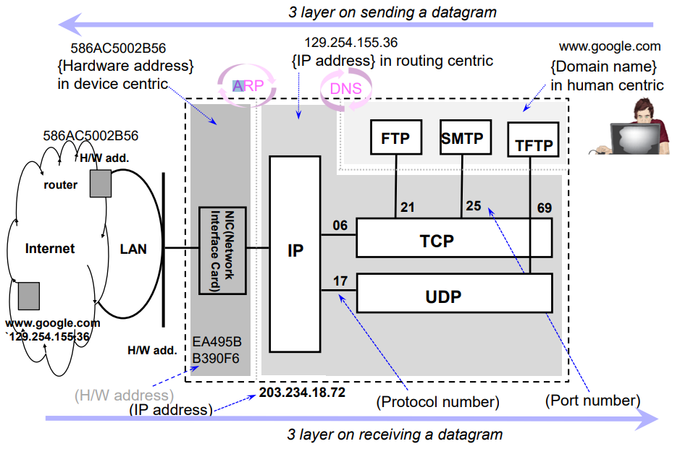
3-layer Internet Addressing

Slide 7
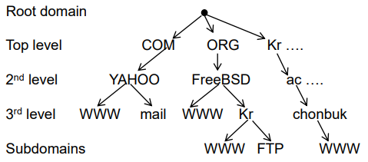
cf) Domain Name
Problem statement
Average brain can easily remember 7 digits
On average, IP addresses have 10.28 digits
So, we need an easier way to remember IP addresses
Makes use of alphanumeric names to refer to hosts
Add a distributed, hierarchical protocol (called DNS)
Address resolution is to map between host names and IP add.
Let’s re-think our DN
www.chonbuk.ac.kr vs www.jbnu.ac.kr

Slide 8
Flow Control
Complex at the transport layer:
Considerable delay in the comm. Of flow control information
The transmission delay may be highly variable, making it difficult to effectively use a timeout mechanism for retransmission of lost data
Reasons for control:
User of the receiving transport entity cannot keep up with the flow
Receiving transport entity itself cannot keep up with the flow of segments

Slide 9
Alternative to Flow Control Requirements
Do nothing
Segments that overflow are discarded
Sending transport entity will fail to get ACK and will retransmit
Thus further adding to incoming data
Refuse to accept further segments from the network service
Relies on network service to do the work
clumsy
Use a fixed sliding widow protocol
With a reliable network service this works quite well
Use a credit scheme
A more effective scheme to use with an unreliable network service

Slide 10
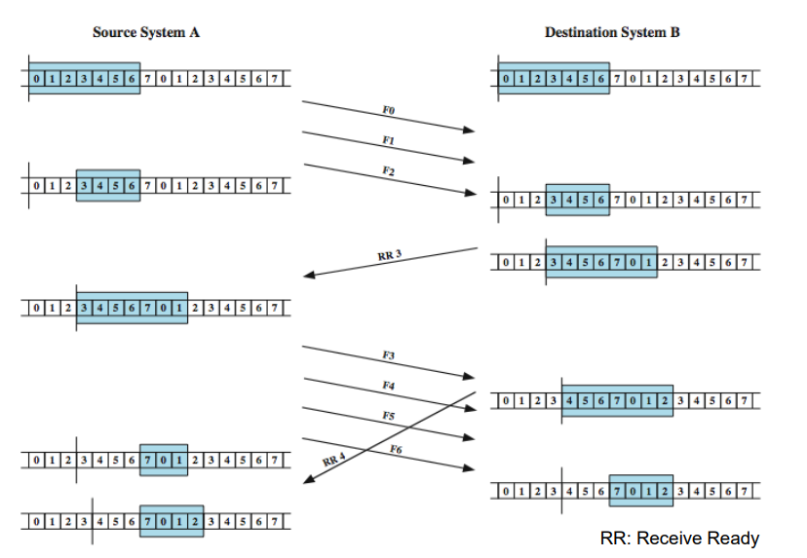
An Example of the Fixed Sliding Window

Slide 11
Credit Scheme
Decouples flow control from ACK
Then, credit scheme mainly rules the flow control
Each octet has sequence number
Each transport segment has sequence number (SN), Ack. Number (AN) and window size (W) in header
Sends sequence number of first octet in segment
ACK includes (AN=I, W=j) which means
All octets through SN=i-1 acknowledged, want I next
Permission to send additional window of W=j octets

Slide 12
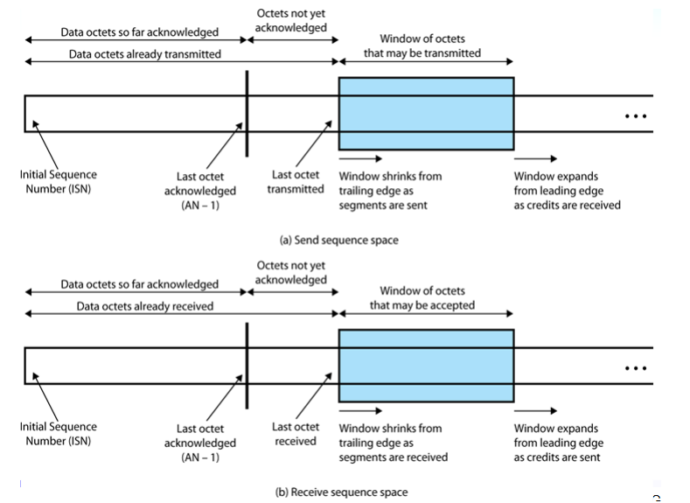
Sending and Receiving Perspectives

Slide 13
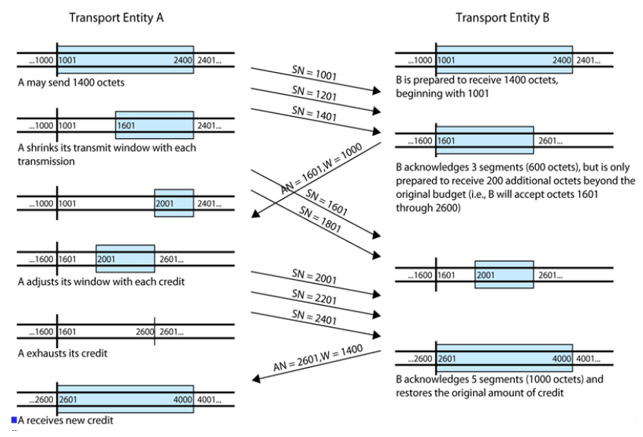
Credit Allocation Mechanism

Slide 14
Connection Establishment and Termination
Serves three main purpose:
Allow each end to assure that the other exists, and the other’s intension to communicate with the initiator
Allows exchange or negotiation of optional parameters
Triggers allocation of transport entity resources
By mutual agreement

Slide 15
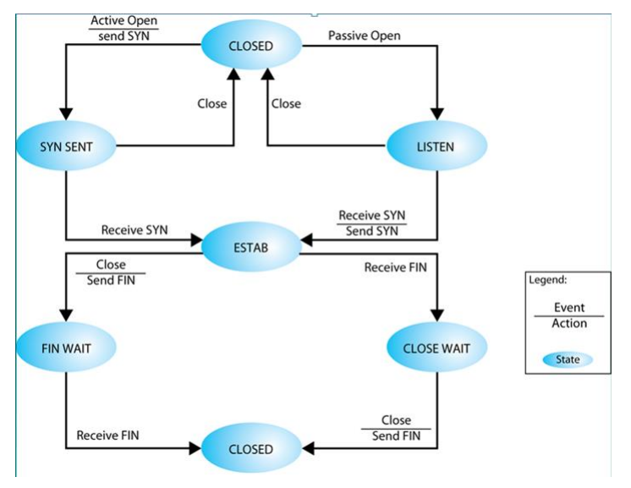
Simple Connection State Diagram

Slide 16
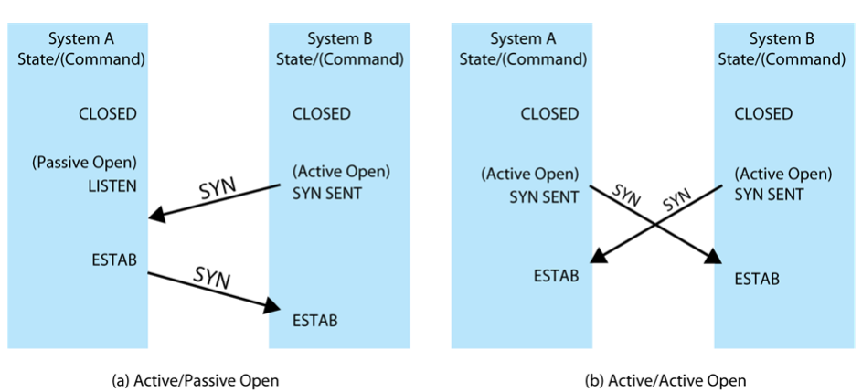
Connection Establishment Scenario

Slide 17
Unreliable Network Service
More difficult case for transport protocol since
Segments may get lost and/or arrive out of order
Examples include
Internetwork using IP
IEEE 802.3 with unacknowledged connectionless LLC service
Issues:
Ordered delivery
Retransmission strategy
Duplication detection
Flow control
Connection establishment & termination
Crash recovery

